Slide 1
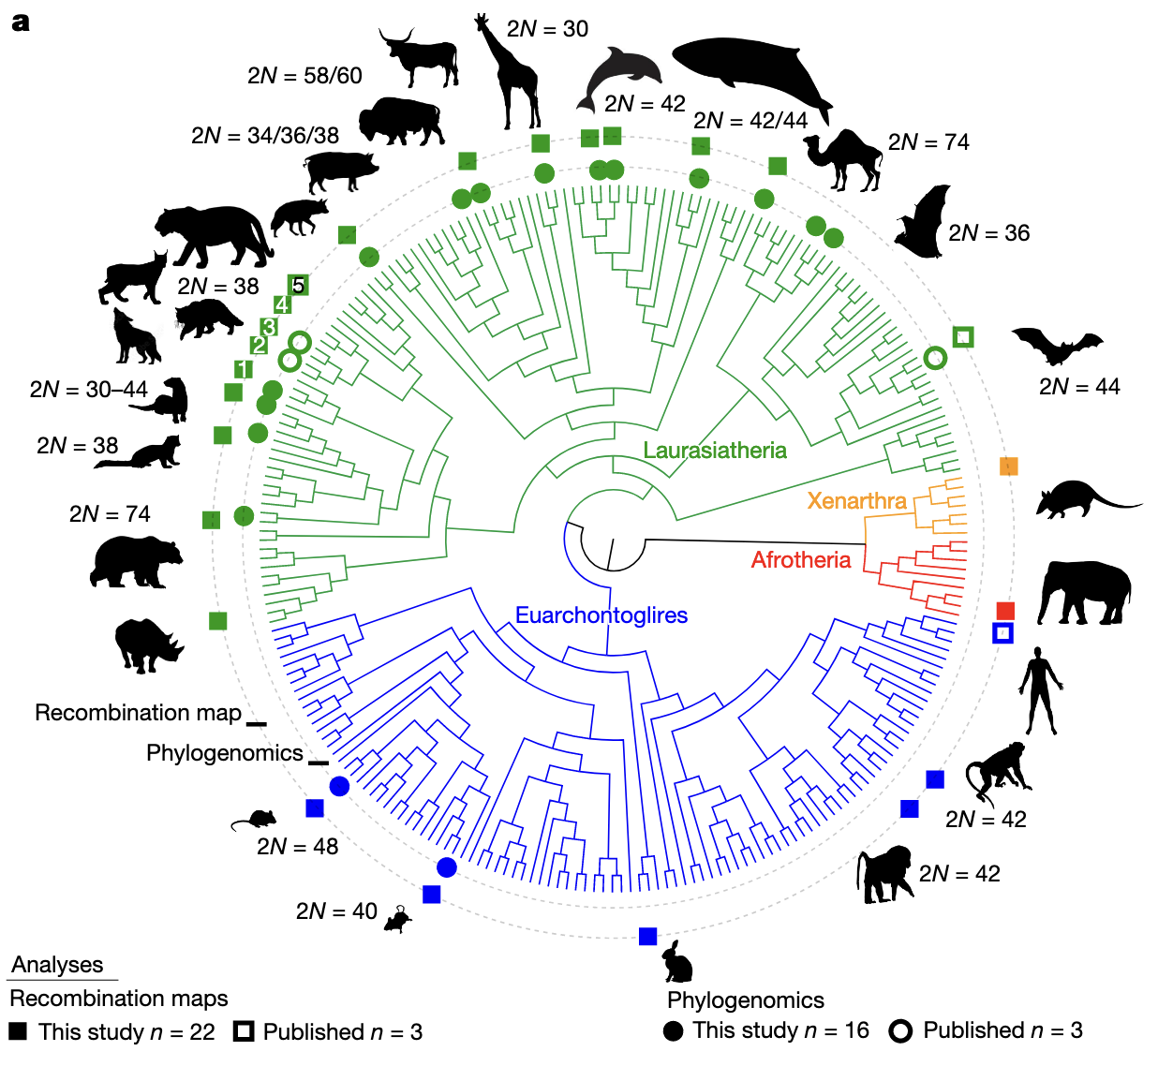
Nicole M. Foley, Richard G. Rasulis, Zoya Wani, Mayra N. Mendoza Cerna, Henrique V. Figueiró, Klaus Peter Koepfli, Terje Raudsepp & William J. Murphy. 2025. “An ancient recombination desert is a speciation supergene in placental mammals” Nature https://doi.org/10.1038/s41586-025-09740-2
Class focus area: Genomics and a speciation desert
EEB603: Brian O’Meara
All quotes and images from the above paper unless otherwise noted

Slide 2
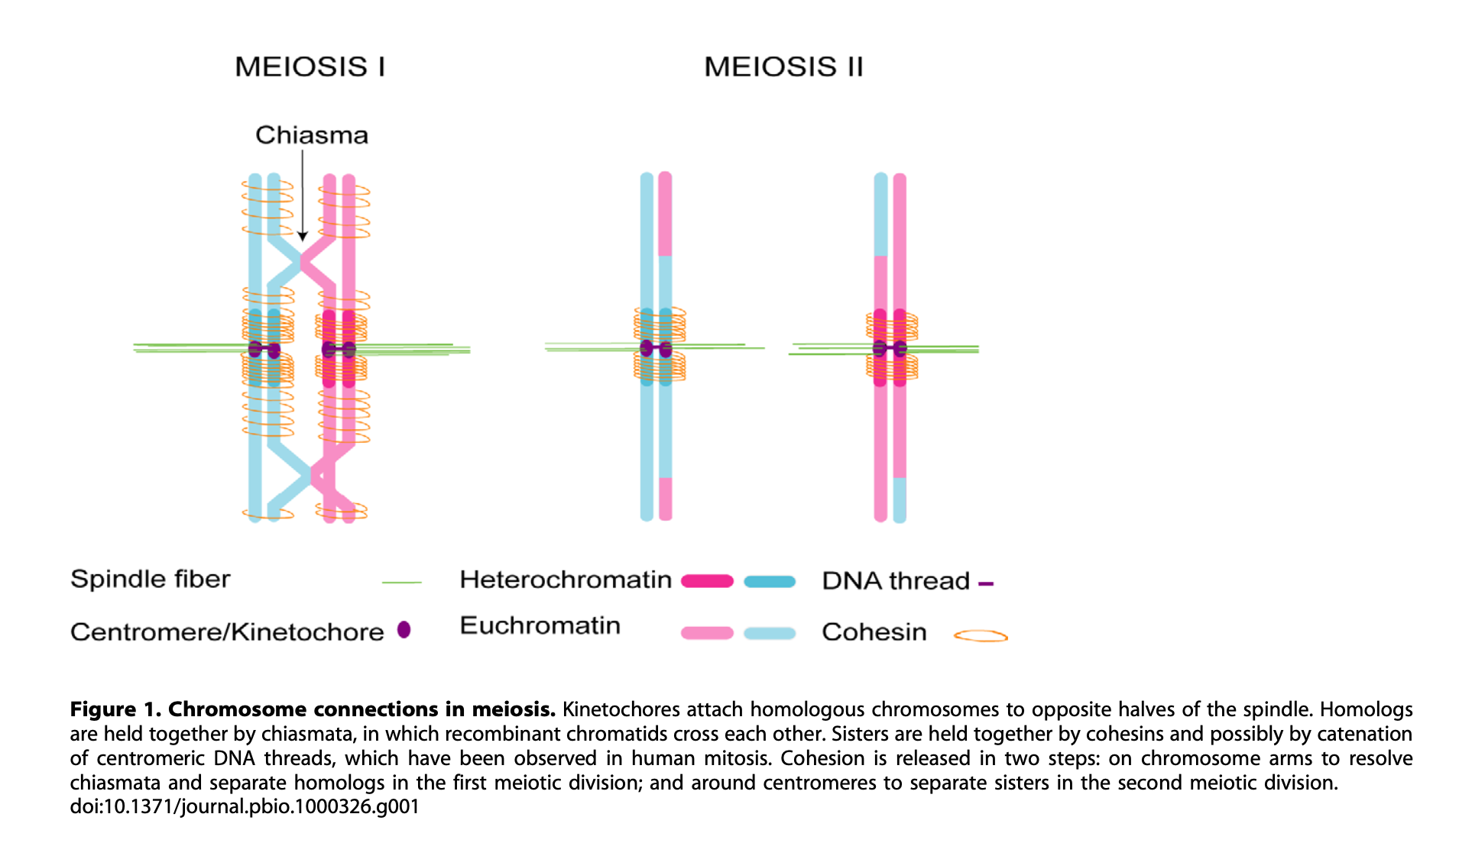
Talbert & Henikoff (2010)

Slide 3

Randall Munroe, https://xkcd.com/1838/
Also see: https://www.explainxkcd.com/wiki/index.php/1838:_Machine_Learning

Slide 4
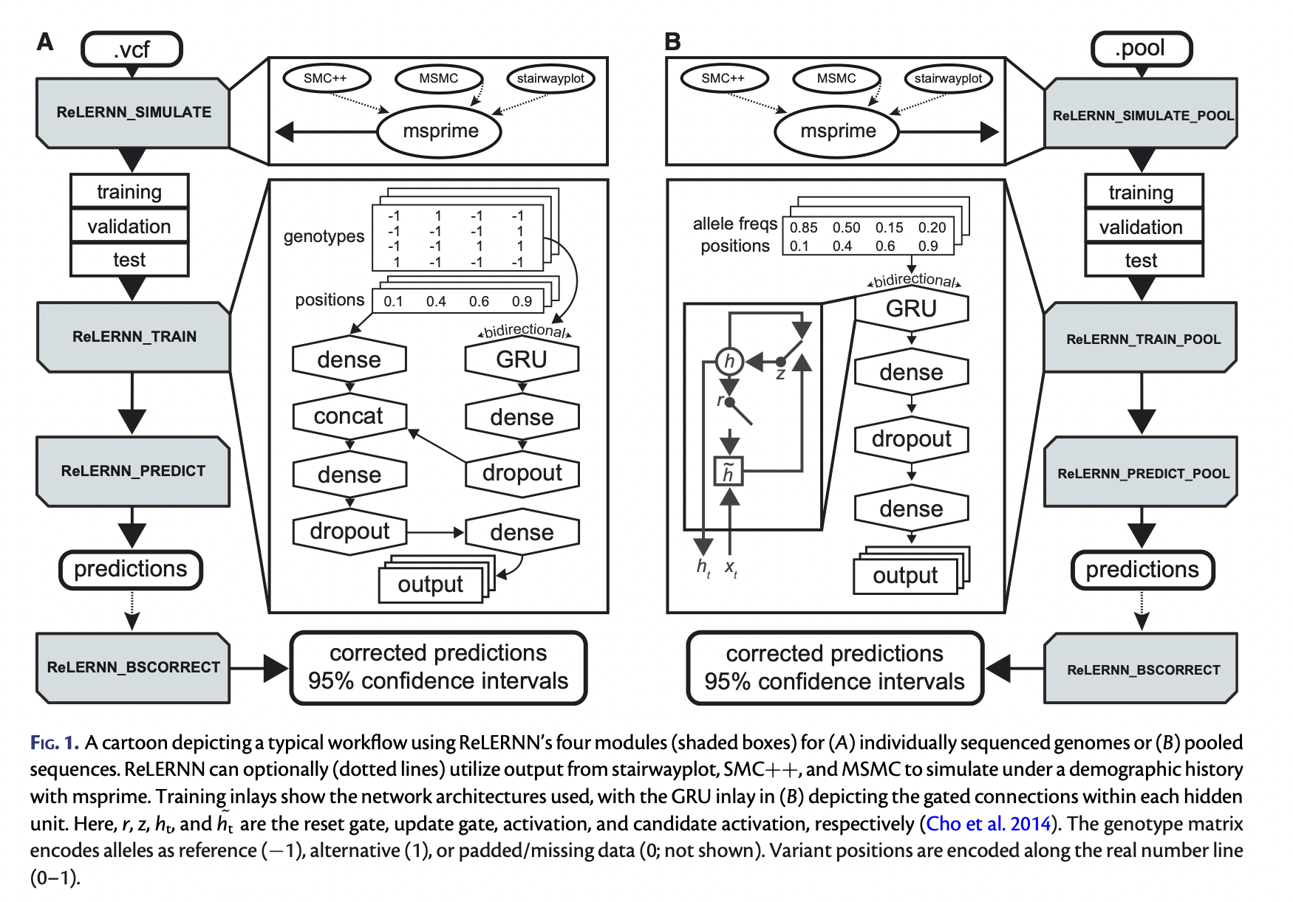
Adrion, Galloway, and Kern (2020) https://doi.org/10.1093/molbev/msaa038

Slide 5
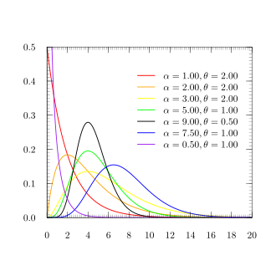
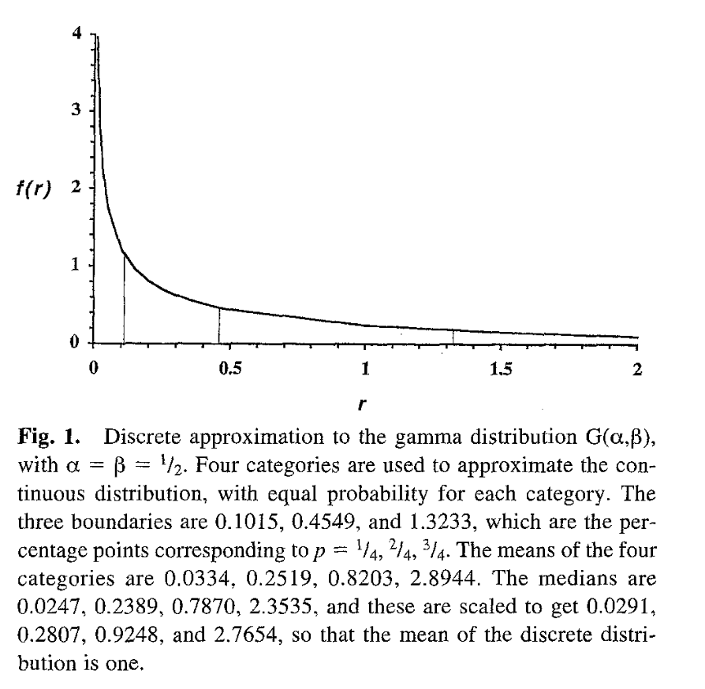
Wikipedia gamma distribution
Yang 1994 “Maximum Likelihood Phylogenetic Estimation from DNA Sequences with Variable Rates over Sites: Approximate Methods” J Molecular Evolution 39:306-314

Slide 6
Notes:
Clades with highly conserved karyotypes were selected across the placental mammal phylogeny and plotted relative to the Zoonomia phylogeny20 to jointly analyse evolutionarily conserved recombination patterns and phylogenomic discordance. The outer circle shows species (marked with squares) for which recombination maps were generated or published. In Carnivora, 1 = Canis lupus, 2 = Prionailurus bengalensis, 3 = Felis catus, 4 = Panthera tigris jacksonii and 5 = Panthera tigris sumatrae. The inner circle shows focal clades (marked with circles) selected for phylogenomic analyses and patterns of introgression.

Slide 7
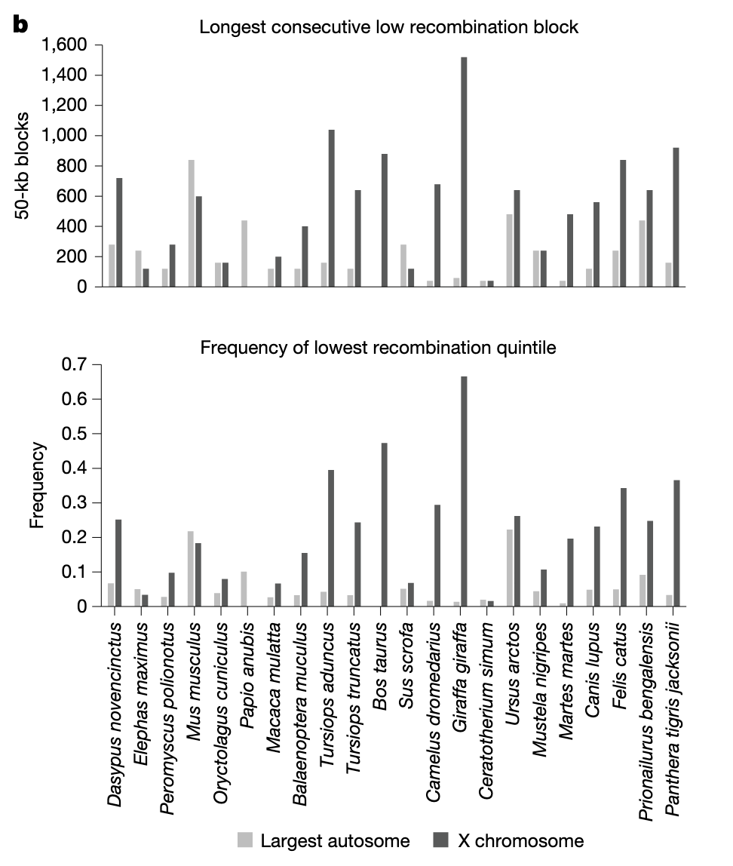
Notes:
For each species, genome-wide recombination rates were divided into quintiles. Given the relationship between recombination rate and chromosome length, we compare the X chromosome with the largest autosome in each genome, as the largest chromosome is expected to have the lowest recombination rate among autosomes. Our results show that, unlike the largest autosome, the lowest recombination quintile is often the most frequent on the X chromosome and tends to form the longest consecutive blocks.

Slide 8
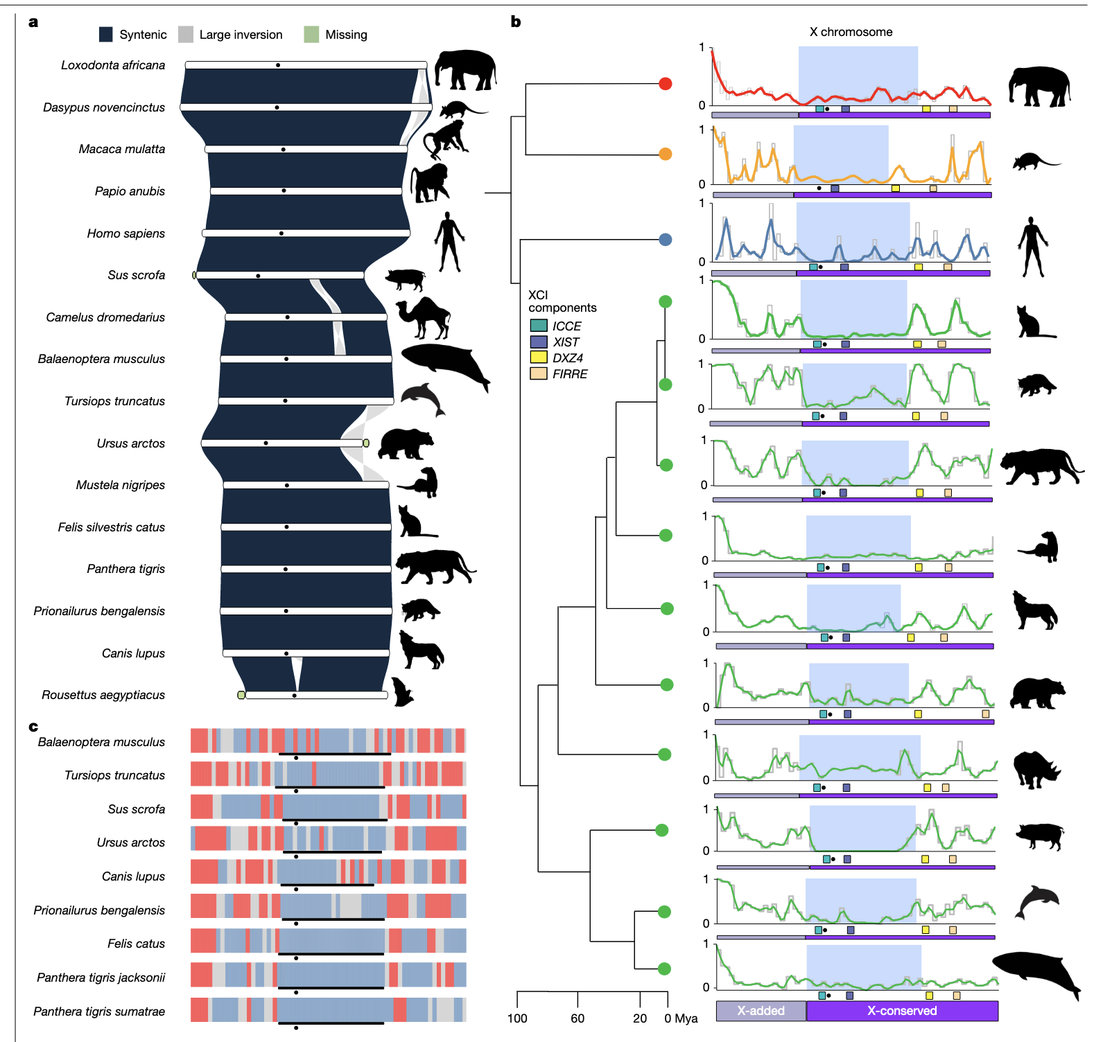
Notes:
a, The X chromosome is largely collinear across most placental mammals. Rarely, collinearity is interrupted by small inversions. A black circle marks the inferred centromere. For humans, the location is determined directly from the complete T2TCHM13v.2.0 genome assembly. Felid centromere locations are orthologous to the human location45. The positions for other taxa are approximated on the basis of assembly inferences (for example, assembly gaps, flanking satellite enrichment) and strong karyotypic conservation61. b, The recombination landscape of the X chromosome remains conserved across placental mammal superorders at both deep and shallow evolutionary levels (indicated by coloured circles matching clades in Fig. 1). The highlighted region (light blue) indicates the XLRD, approximately spanning the interval between JADE3 and CHRDL1. Loci involved in 3D X chromosome superlooping, ICCE, XIST, DXZ4 and FIRRE, are shown below each X chromosome map. The grey and purple bars under each chromosome represent the XAR and the XCR, respectively. The XAR–XCR boundary marks the proximal boundary of the XLRD. Recombination rates are normalized to the highest value on the X chromosome. c, Quintile values of the two lowest (blue) and highest (red) recombination rate categories reveal the preservation of the recombination landscape on the X chromosome across species; this preservation is especially evident in Laurasiatheria. The XLRD (black line) is flanked by several smaller, multi-megabase, conserved, cold and hotspots. The pseudoautosomal region is located at the left end of each chromosome map.

Slide 9
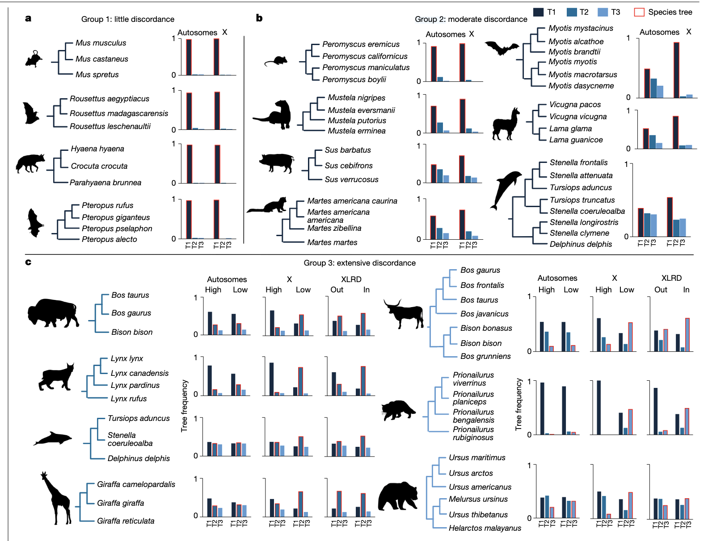
Notes:
–c, Mammal clades show variable amounts of phylogenomic discordance related to introgression. T1 topologies represent the most common locus tree across the genome, whereas T2 and T3 are the second and third most frequent topologies, respectively. In all cases, the topology most consistent with the species tree is outlined in red. Comparisons of tree topology frequencies between autosomes and the entire X chromosome are shown for groups 1–3. a, Group 1 clades with little discordance. b, Group 2 clades with moderate discordance. Group definitions are provided in the main text. The three most frequent topologies and their genome-wide distributions for each clade are shown in Supplementary Figs. 25–40. c, Group 3 clades with extensive discordance show recombination-related discordance on the X chromosome and autosomes. Tree frequencies are asymmetric, with different topologies enriched between the X chromosome and the autosomes and between high and low recombination regions. Species-tree frequencies are also most common in the XLRD. D-statistics, QuIBL and analysis of the alpha shape parameter were used jointly to identify discordant topologies related to introgression or ILS (Supplementary Tables 6, 7 and 9).

Slide 10
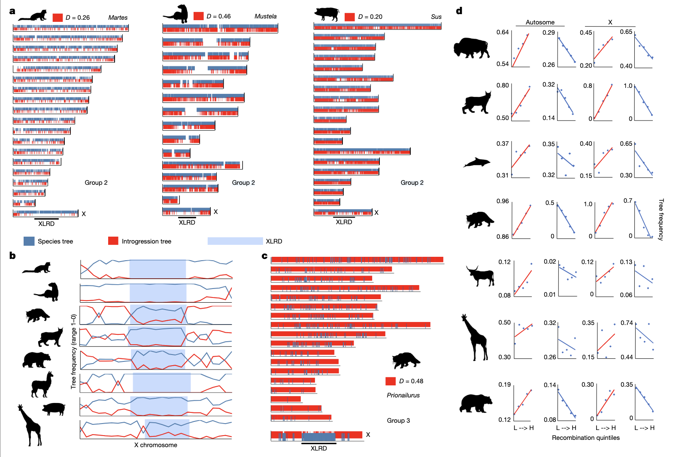
Notes:
Genome-wide distribution patterns of species (blue) and introgression (red) locus trees show that the XLRD acts as a barrier to gene flow and serves as a reliable phylogenomic marker. a, The species tree is enriched on the X chromosome and at the centres of large metacentric autosomes, but depleted at telomeres in three mammal groups classified as group 2, which exhibit moderate discordance due to introgression: Myotis (little brown bats), Martes (martens), Mustela (ferrets) and Sus (pigs). The introgression signal is stronger at telomeres and shifts gradually towards the species tree as it approaches the centromeres, where recombination is lower and background selection is more effective. b, Among placental mammal clades, the frequency of the species tree (blue line) is consistently highest within the XLRD. The species tree, inferred to be the most common topology on the X chromosome (and XLRD), exhibits an inverse relationship with recombination quintiles. c, These patterns are most noticeable in group 3 clades, which show extensive discordance due to introgression, such as in the leopard cat lineage (Prionailurus), where the species tree is clustered prominently on the X chromosome. d, The species tree, identified as the most frequent topology on the X chromosome (and XLRD), again shows an inverse relationship with recombination quintiles for group 3 clades. Similar plots for group 2 clades are presented in Extended Data Fig. 6.

Slide 11
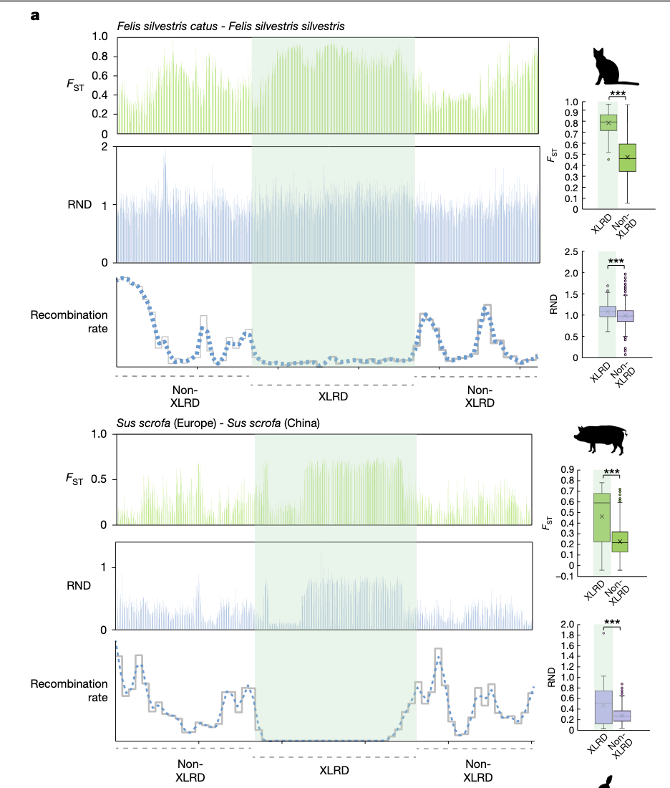
Notes:
Significant patterns of differentiation, defined by elevated FST and RND values, are observed in the XLRD of the collinear X chromosome among sub-populations of Felis silvestris (FST W = 967,418; P ≤ 2.2 × 10−16; RND W = 676,916; P ≤ 2.2 × 10−16) and Sus scrofa (FST W = 1,090,762; P ≤ 2.2 × 10−16; RND W = 969,461; P ≤ 2.2 × 10−16). Error bars indicate maximum and minimum values outside of the interquartile range.

Slide 12
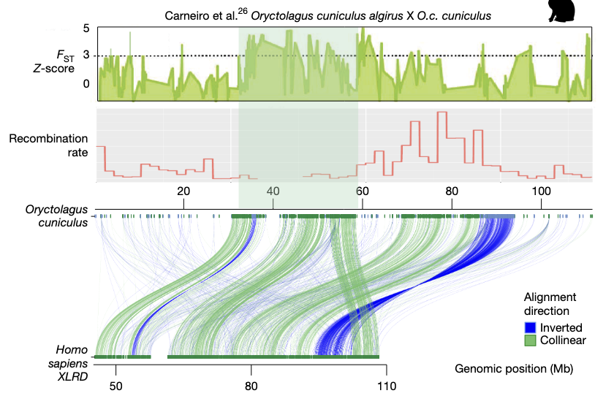
Notes:
SVbyEye plots show that the Oryctolagus cuniculus X chromosome is largely collinear within the XLRD and possesses increased differentiation in a region with synteny to the human XLRD. Matching patterns of elevated RND in this region are described in the original manuscript26.

Slide 13
Deep learning algorithm?
Why just X, why not Y?
Syntenic alignments? Haldane’s rule? Chromosome enrichment? Dosage compensation?
Is there evidence this occurs beyond mammals?
Also how uncertain are we about some of the realtionships within mammals? I know the broad (Afrotheria, Laurasiathera, etc.) seem stable from what I have seen, but how much uncertanty do we have?
It makes me wonder which region is so well-conserved in plants (chloroplast?), given that they don't exhibit much sexual isolation

